Slide 1
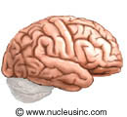
Activity 2.2.5 Communication Breakdown
By: Danielle Glass

Slide 2
Patient Background (#5)
This patient is a 45- year old male who has noticeable changes in his muscles, balance and coordination, and speech.
Symptoms:
Muscles in hands and feet feel weak
Muscle twitch from time to time
Trouble lifting weights due to weakness of muscles
Tripping and stumbling (Lack of balance)
Trouble projecting voice
Slightly slurred speech

Slide 3
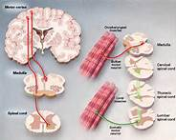
Diagnosis
The patient has been diagnosed with Amyotrophic Lateral Sclerosis, also known as ALS, from a neurologist or physician.
The patient was diagnosed from a physical exam and multiple tests to determine how muscles and nerves are working such as:
Electromyogram (EMG)- determines muscle and nerve functions
Muscle Biopsy- a test of extracted muscle tissue.
Nerve Conduction Studies- nerve function
The symptoms that led to this diagnosis included the muscle weakness and twitching.

Slide 4
What is ALS???
Amyotrophic lateral sclerosis (ALS), often referred to as "Lou Gehrig's Disease is a condition that affects nerve cells in the brain.
The common symptoms of this disease are muscle weakness, loss of voluntary movement control, stiffness and twitching.
To understand its meaning, lateral means sides of the spinal cord (where the nerves are) and sclerosis means the part of the spinal cord that develops hardened tissue.

Slide 5
Occupations
Neurologist: Help identify where the nerves are affected as well as diagnose the disease itself.
Physical Therapist: Provide physical therapy for patients in order to reduce muscle pain, increase mobility, and reduce stiffness.
Physician: Consistently checks up on patient and how they are coping with the disease/diagnosis.

Slide 6
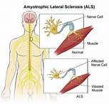
Treatments
Unfortunately, ALS has no cure. Treatment is based on the individual and mainly focuses on reliving symptoms and maintaining comfort.
Certain medications can be helpful, but ALS is still not completely controlled.
Physical therapy can also be helpful for controlling symptoms.

Slide 7
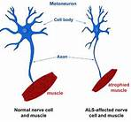
Living a Healthy Life with ALS
Unfortunately, many people do not live more than 10 years after their diagnosis of ALS.
Luckily, with the time they do live, their mind is not affected. Many people explain that although life is physically difficult, their brain still functions normally allowing for a positive outlook.
Also, communication can sometimes be difficult, but many families learn to work together to make communication problems easier.

Slide 8
Works Cited
http://www.webmd.com/brain/tc/amyotrophic-lateral-sclerosis-als-topic-overview
http://kidshealth.org/kid/grownup/conditions/als.html
http://www.healthcommunities.com/als/treatment.shtml
http://www.webmd.com/brain/understanding-als-treatment

