Slide 1
Diabetic Innovation
By: Danielle, Laine, & Dani

Slide 2
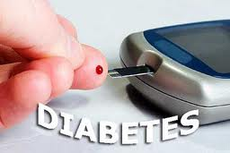
What is Diabetes?
Diabetes is a disease of the pancreas. There are two main types of the disease; Type 1 and Type 2.
Type 1: The pancreas is not able to produce any insulin at all.
Type 2: The pancreas is able to produce insulin but the body is unable to use it.
Diabetes can affect any ages.
Diabetes causes many other complications of many body systems.

Slide 3
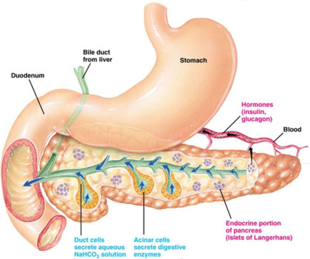
How Does the Pancreas Work?
The pancreas releases substances into the small intestine to help with digestion.
The pancreas also produces and releases insulin to regulate blood sugar in the body.

Slide 4
Why Won’t A Donor Pancreas Work?
There are surgeries today that allow a cadaver to donate a pancreas. But, there are many complications that can follow the process that are often worse than diabetes itself.
Complications:
Body refuses organ
Immunosuppressive drugs
Operation
Not enough donors and match-ups
One- Two people out of 10 die within a year of the surgery.

Slide 5
Which type is most benefited?
Type 1 is the most benefited from a possible pancreas transplant. This is because Type 1 does not produce any insulin.
With this transplant, insulin will be able to be produced.

Slide 6
Design
The pancreas transplant must be created in a way that the body will not reject it when it is replaced.
The pancreas transplant must also be able to function normally and reduce insulin as needed.
This transplant would have a way where it can be refilled monthly instead of having to take shots daily with a small external port.

Slide 7
Design (cont.)
The transplant would have 3 chambers. One for insulin, glucagon, and pancreatic fluid.
Like the pacemaker, this transplant would be able to detect glucose levels in the blood by sensors.
The sensors would be able to be release the proper hormone needed to regulate the body levels.
The sensors would need to be connected with ducts to the bloodstream in order to allow insulin to flow through the body.

Slide 8
Citations
http://www.diabetes.org/living-with-diabetes/treatment-and-care/transplantation/pancreas-transplantation.html
http://www.madehow.com/Volume-3/Pacemaker.html
http://www.montana.edu/wwwai/imsd/alcohol/Vanessa/vwpancreas.htm
http://www.endocrineweb.com/conditions/diabetes/diabetes-what-insulin

