Slide 1
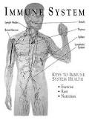
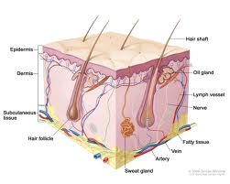
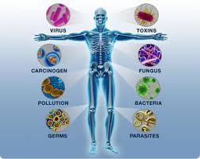
The Immune System
By: Danielle, Laine, Dani, & Kylie

Slide 2
Function of the System
The main function of the Immune System is to protect the body from illness and injury. The immune system is made up of special cells, tissues, and organs. This system can be affected by illnesses such as Urinary Tract Infections, Sickle Cell Anemia, Diabetes, and Heart Disease.

Slide 3
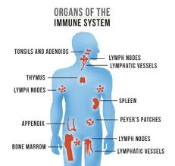
Structures
B Cells
Lymph Node
Spleen
Skin
Thymus
T Cells
Phagocytes

Slide 4
Function of Each Structure
B Cells: Secretes antibodies into the body fluids
Lymph Node: Filter out all the dead bacteria, viruses, lymphatic fluid, and eliminate it from the body.
Spleen: Filters the blood and fights bacteria
Skin: Protects body from infection and injury, regulates temperatures, and allows sensations.
Thymus: Produces and processes T Cells.
T Cells: Control Immune System reactions by stimulating multiple cells within the system.
Phagocytes: Ingests microorganisms and harmful particles.

Slide 5
How The Immune System is affected by each illness
Urinary Tract Infection: The system works to fight off bacteria causing the infection
Sickle Cell Anemia: Sickled cells reduce blood flow causing germ-fighting cells not to be delivered leading to increased chances of infections.
Diabetes: Makes the body vulnerable to infections that may not occur otherwise
Heart Disease: The system works to reduce inflammation in the heart because of the disease.

Slide 6
Works Cited/Resources
Endocrine awareness center for health . (2012). Retrieved from https://eaware.org/thymus-gland/
NHL Cyberfamily. (2010). Non-hodgkin. Retrieved from http://www.nhlcyberfamily.org/nodes.htm
The Immune System (2013). http://kidshealth.org/parent/general/body_basics/immune.html
Phagocyte (2013). http://medical-dictionary.thefreedictionary.com/Phagocytes
(2013). T cell. Brittanica: Academic Edition. Retrieved from http://www.britannica.com/EBchecked/topic/579428/T-cell
(2012). Digestive Disorders Health Center. WebMD.com. Retrieved from http://www.webmd.com/digestive-disorders/picture-of-the-spleen

